Slide 1
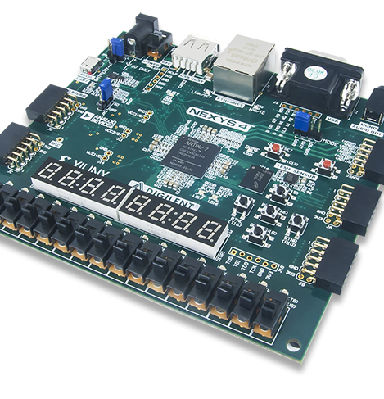
Lab 6
Group_D:
Laurice Sattouf
Choi Tim Anthony Young
Dimitri Garcia
Professor:
Mohamed El-Hadedy
California Polytechnic State University Pomona, California

Slide 2
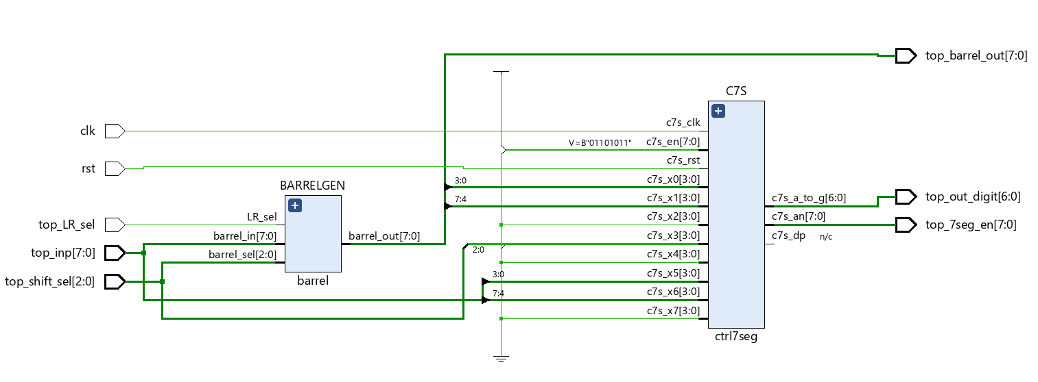
Assignment
Design a Barrel shifter that allows rotating right and left on an eight-bits input.
Assign control inputs to decide the amount of rotate needed.
Assign control input to decide the direction of rotation, left or right.
Make the following specification for the display:
2 digits for the inputs.
2 digits for the outputs.
1 digit for control.
All possible corner cases should be defined using a testbench textio.

Slide 3
Coding Steps
Mux entity as a basic component.
Generic barrel shift component.
7segment unit.
Top unit to wrap all the units and implement the required design.

Slide 4
Schematic

Slide 5
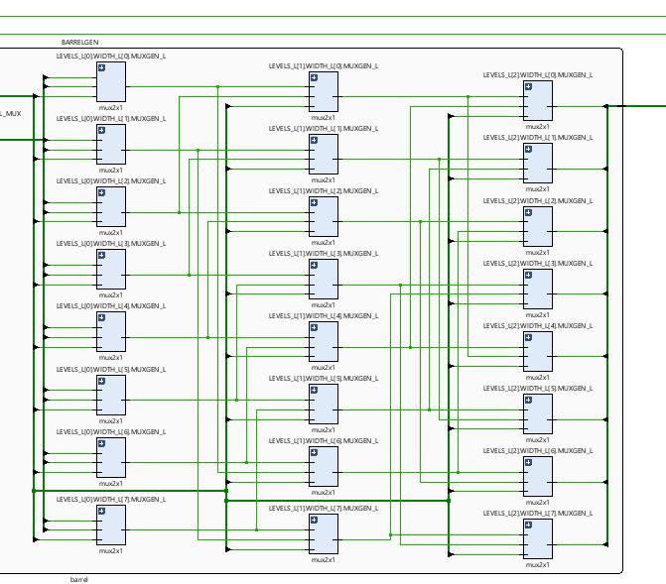
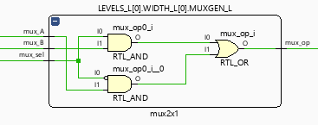
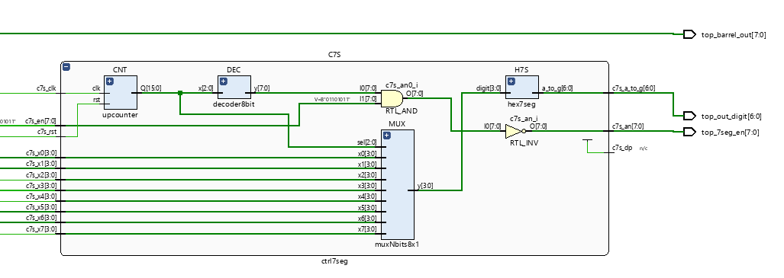
Schematic Components in Details
Generic Barrel Shifter Component
Mux Component
7-Segmet Component

Slide 6
Power and Resources

Slide 7

Work Distribution
We had a meeting to brainstorm and explain the main idea of the lab, and we created the schematic so that everyone would work individually to achieve the most optimized design.
We had a zoom meeting to choose the design with less power consuming, then we were able to demo our implemented design and cover all the corner cases.
Documentation and reports were evenly distributed, and it covered all the steps of our successfully implemented design.

